Slide 1
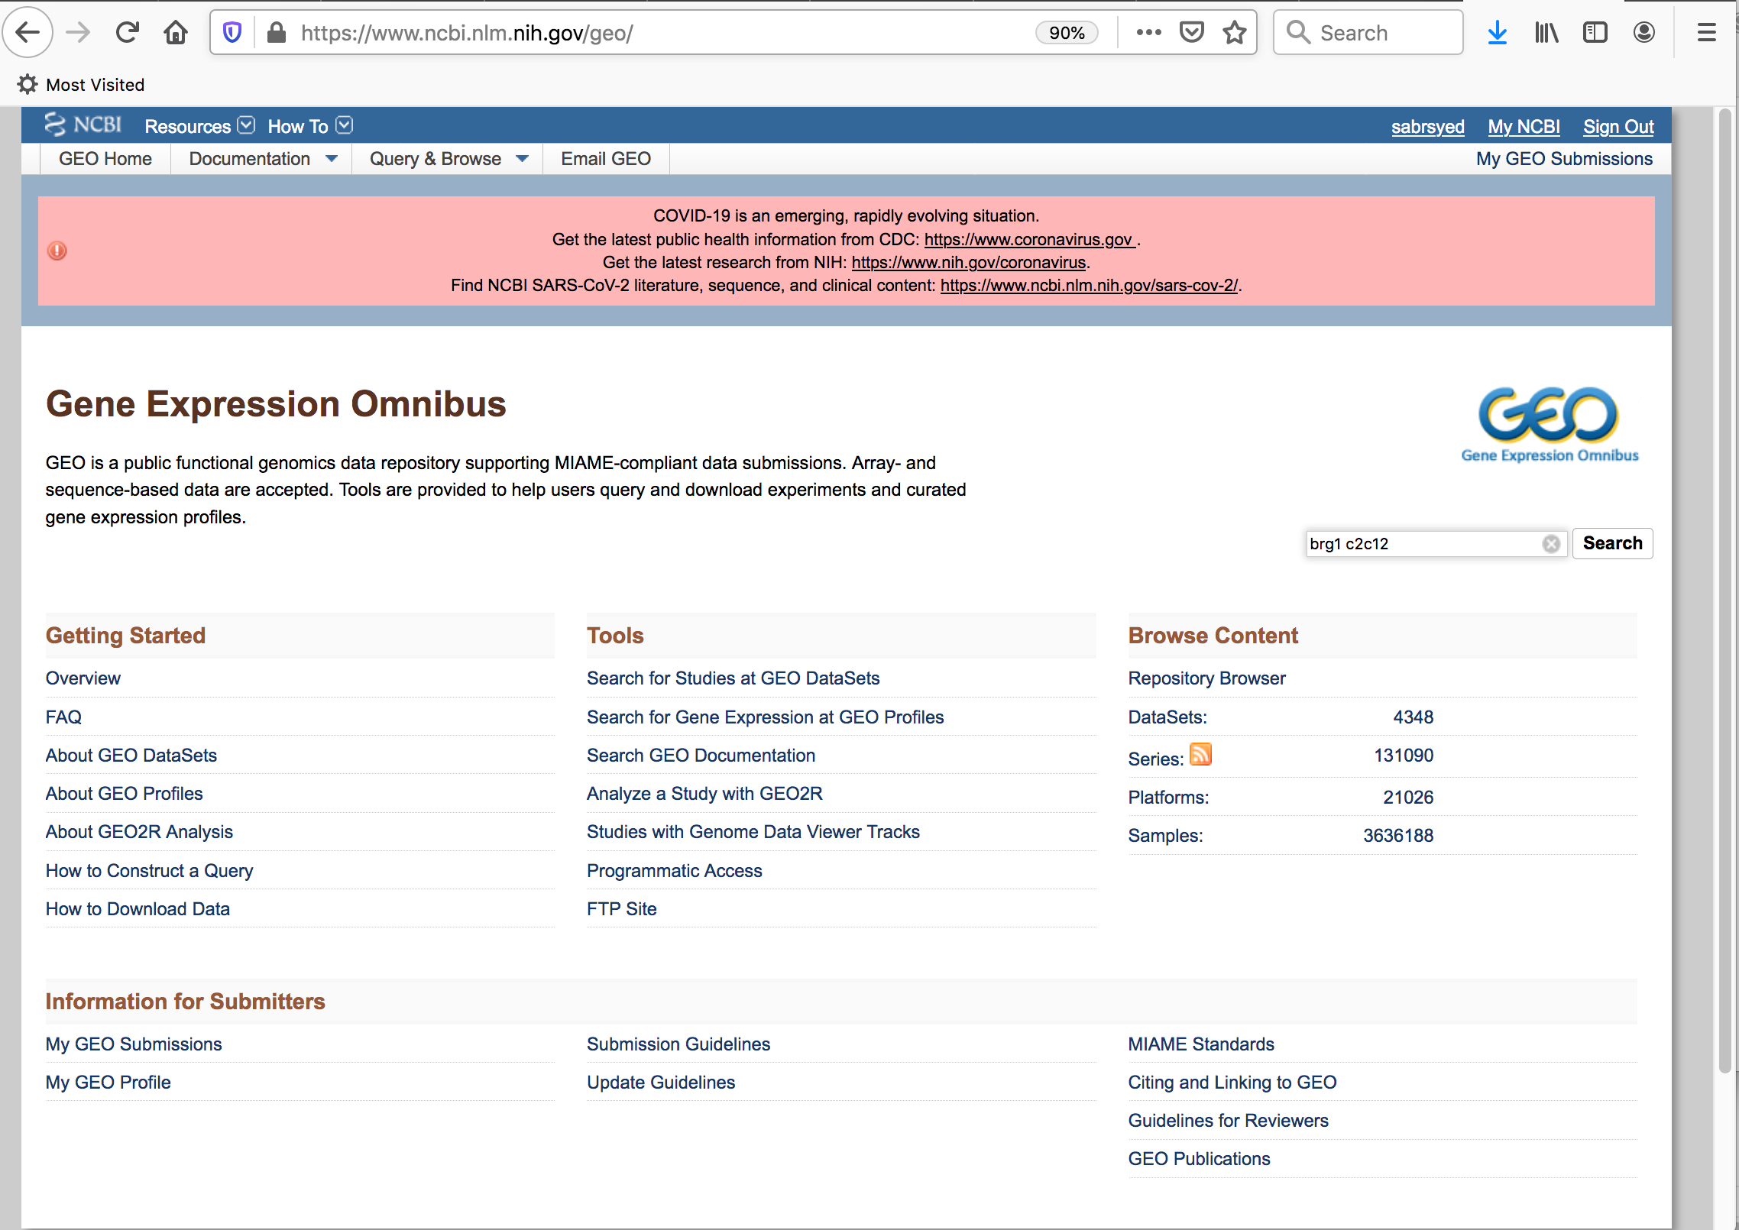
https://www.ncbi.nlm.nih.gov/geo/

Slide 2
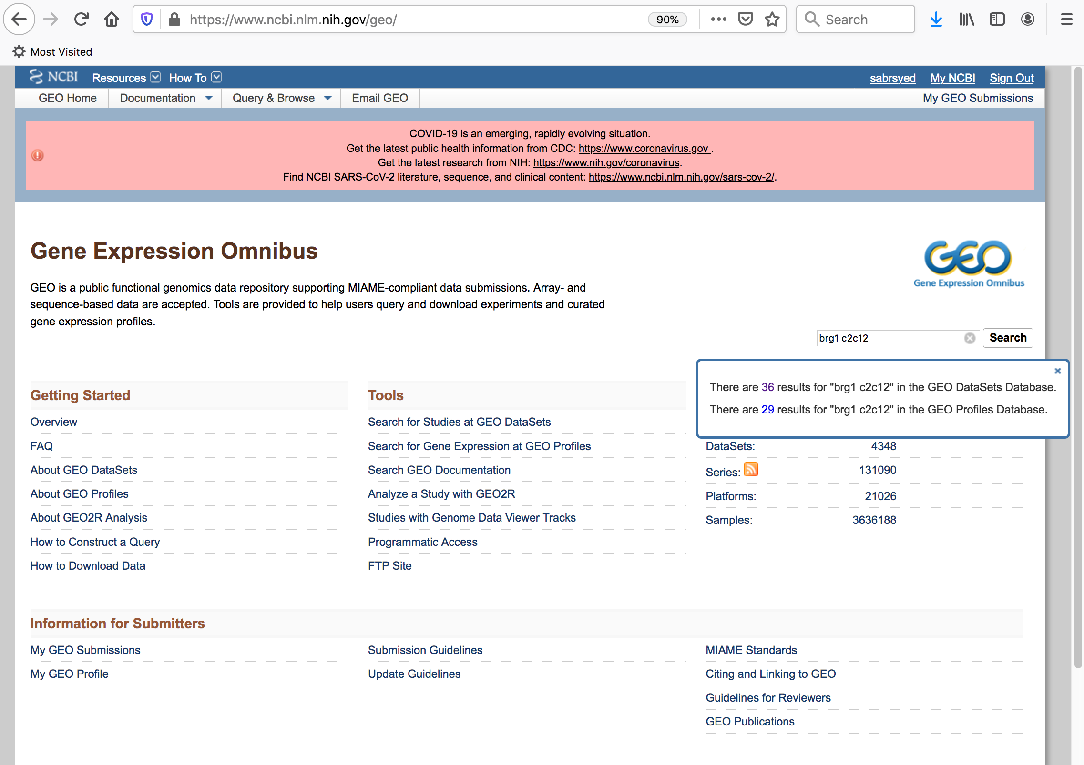
https://www.ncbi.nlm.nih.gov/geo/

Slide 3
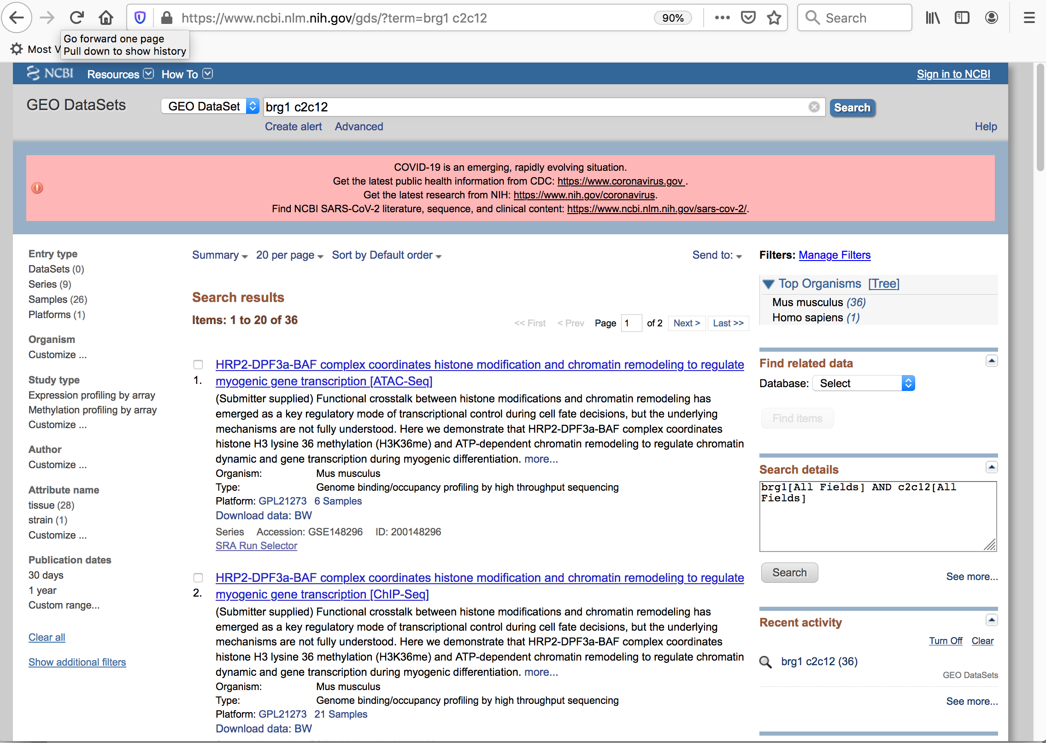
https://www.ncbi.nlm.nih.gov/geo/

Slide 4
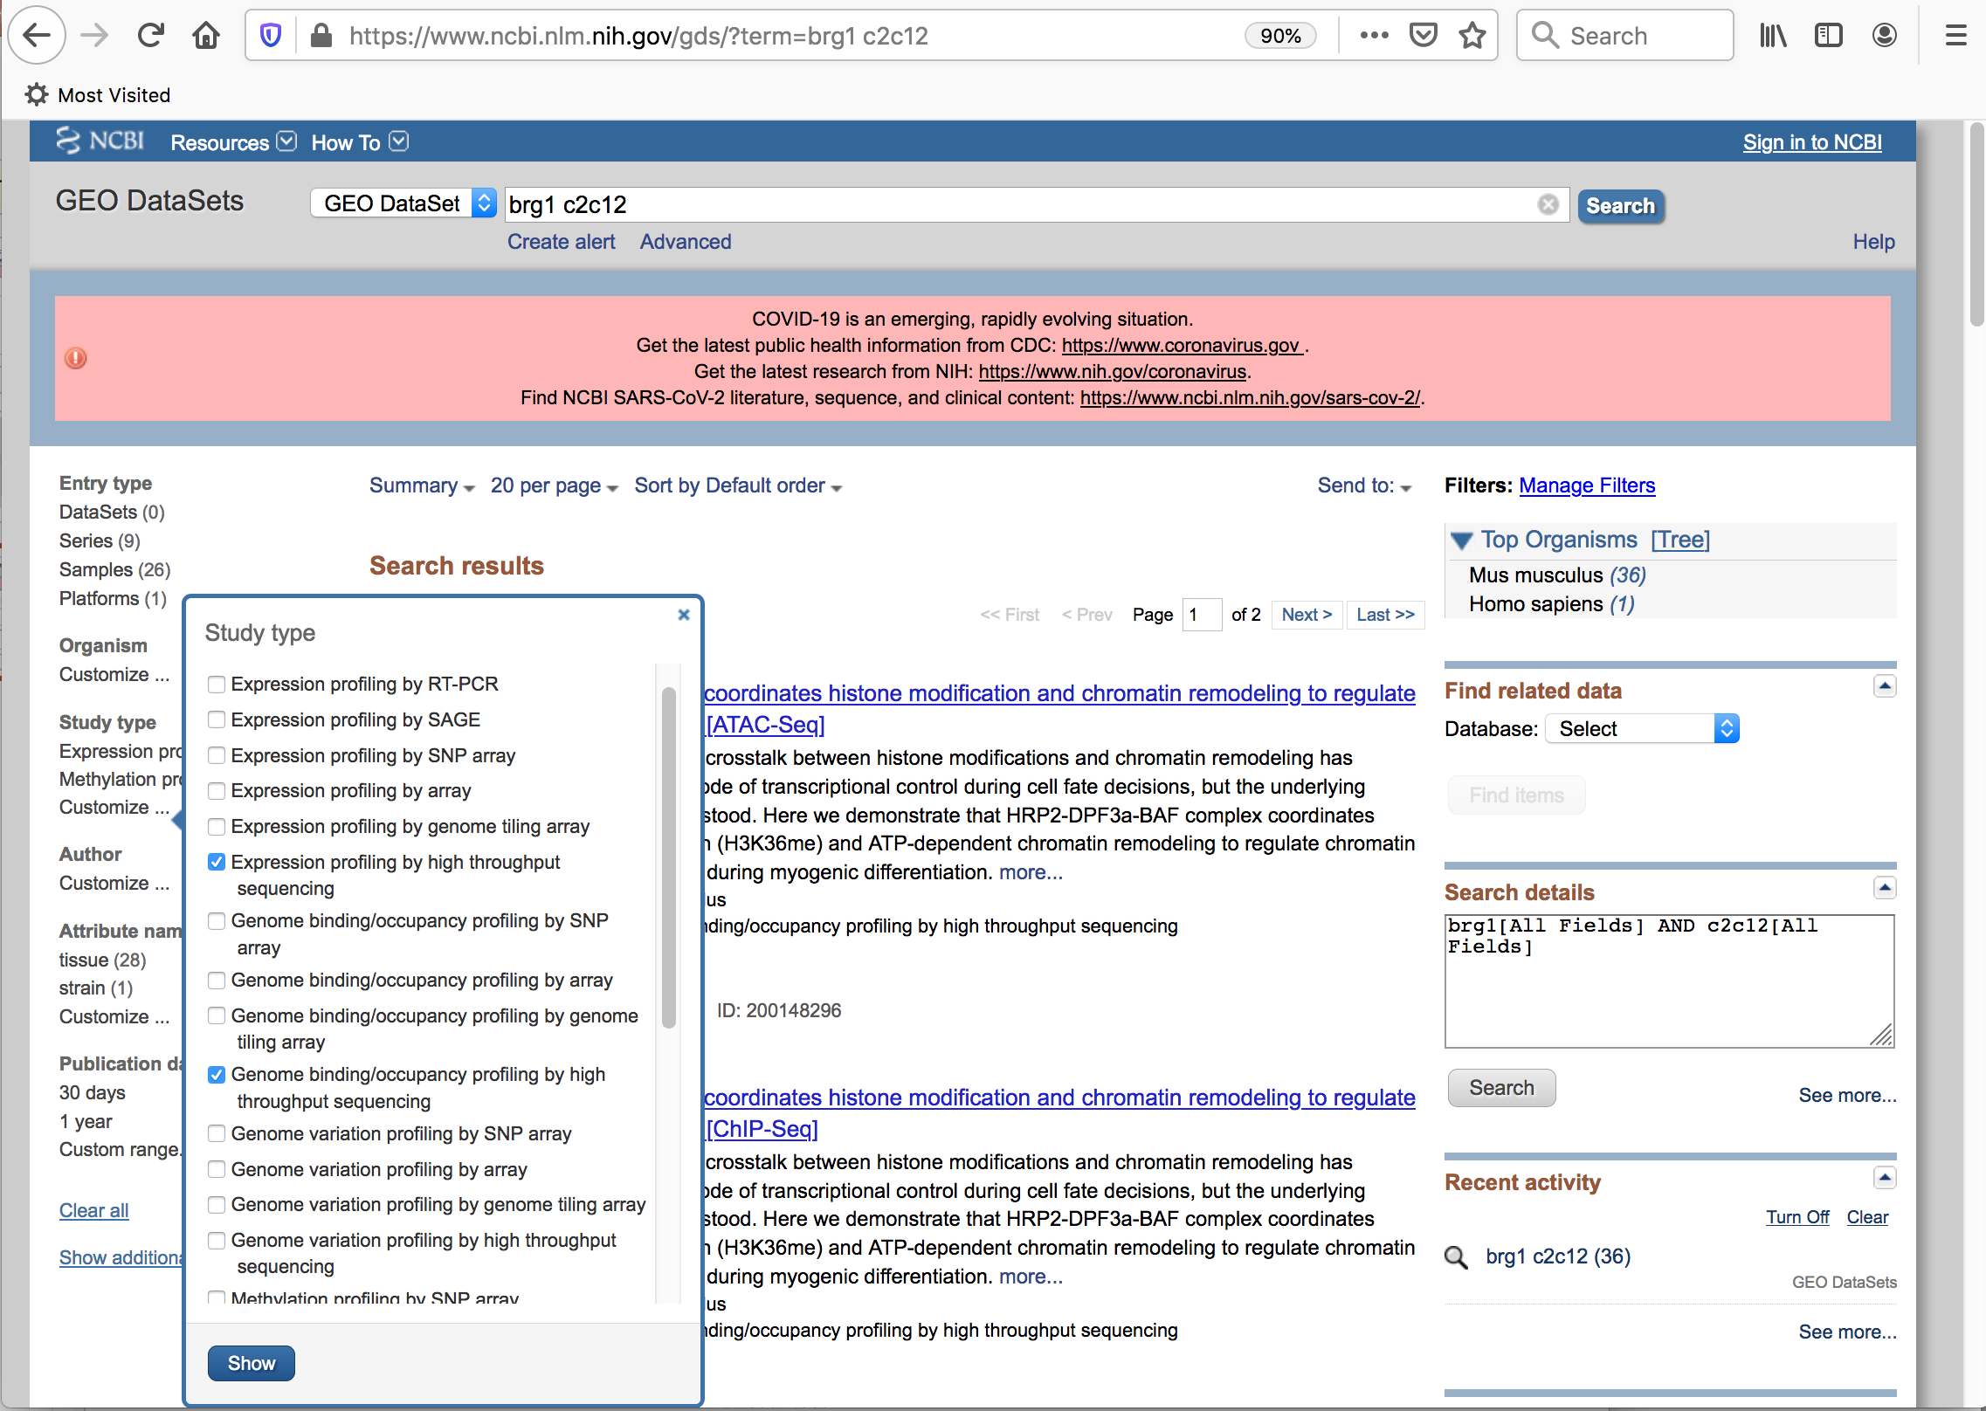
https://www.ncbi.nlm.nih.gov/geo/

Slide 5
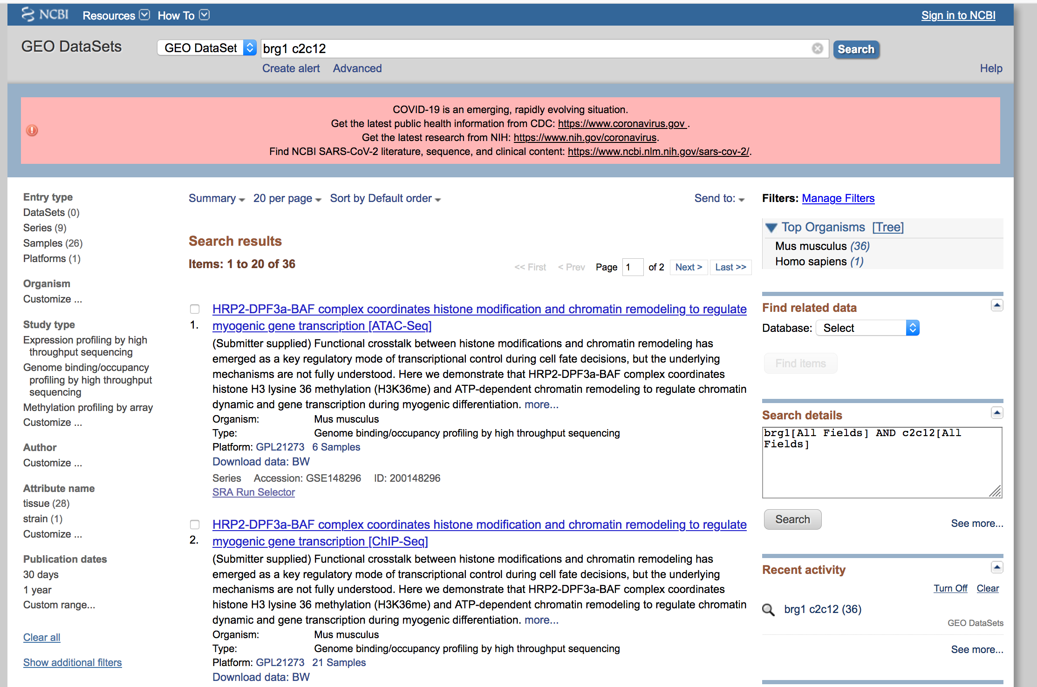
Click expression profiling by high through sequencing to see all RNA-Seq datasets

Slide 6
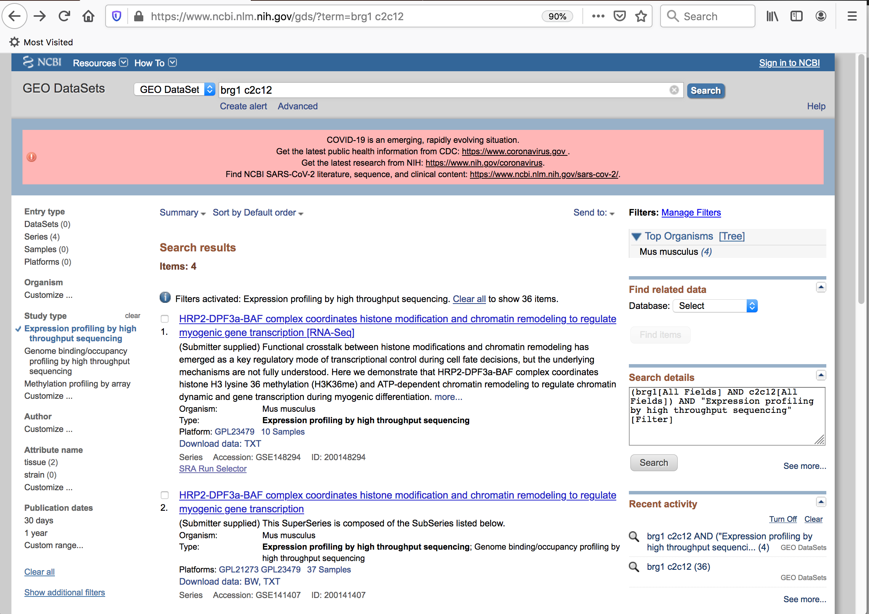

Slide 7
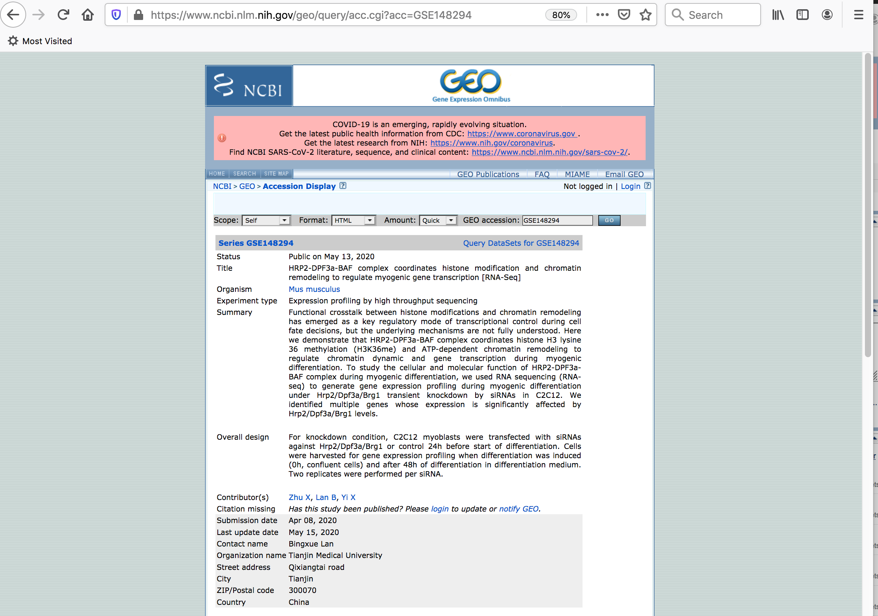
Scroll down for series matrix file and processed data files

Slide 8
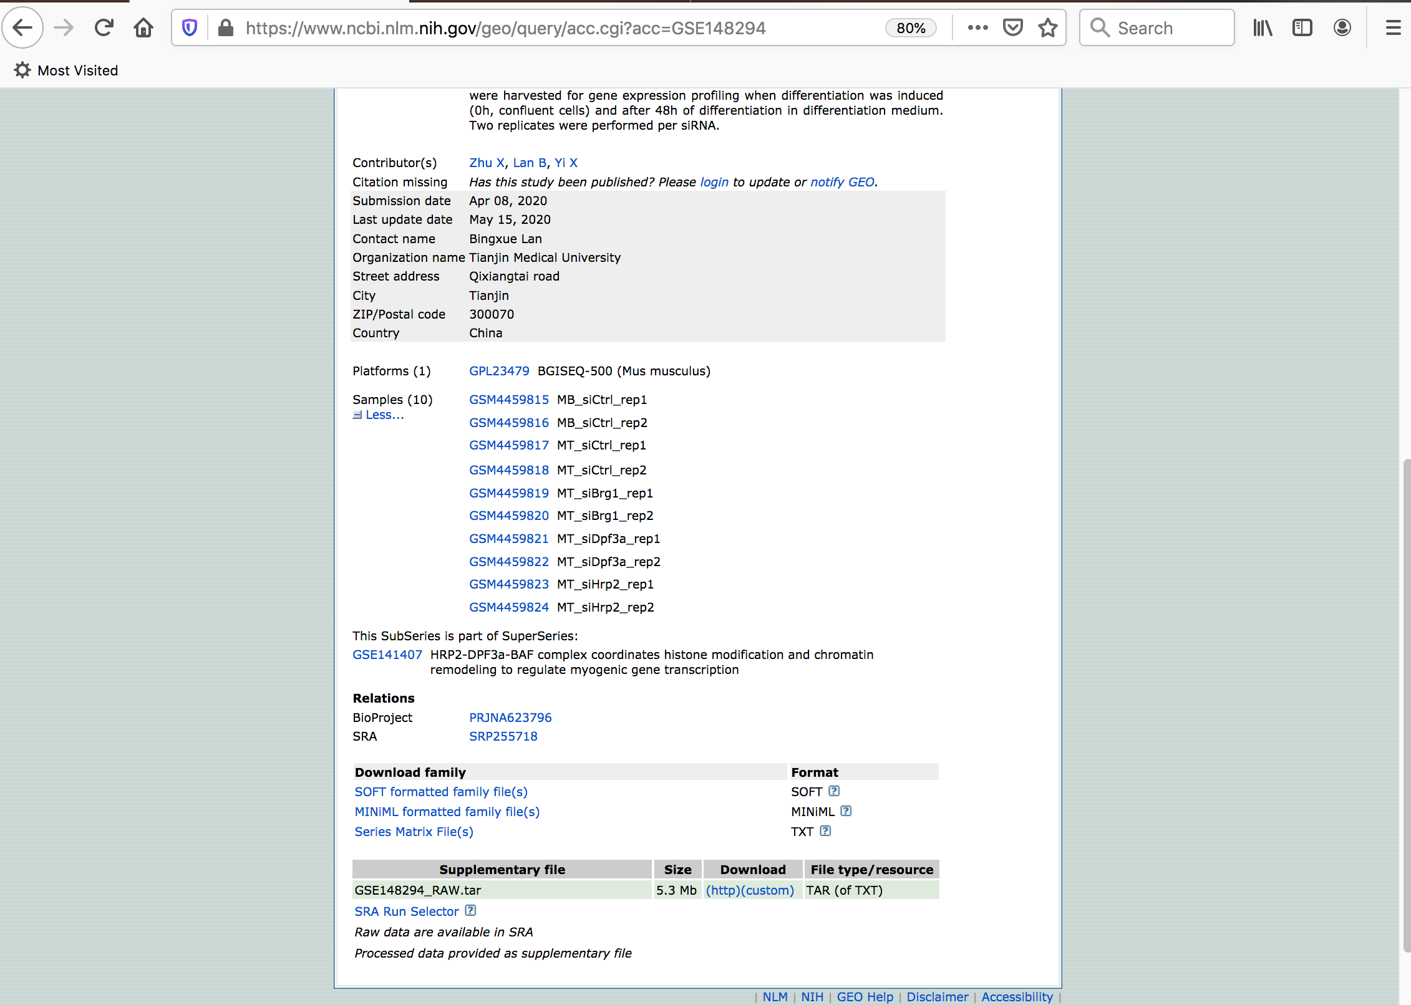
Download series matrix file, unpack, and open with Excel to read about Experimental conditions, harvesting protocol, and data analysis pipeline

Slide 9
Click ‘Custom’ to see the processed files

Slide 10
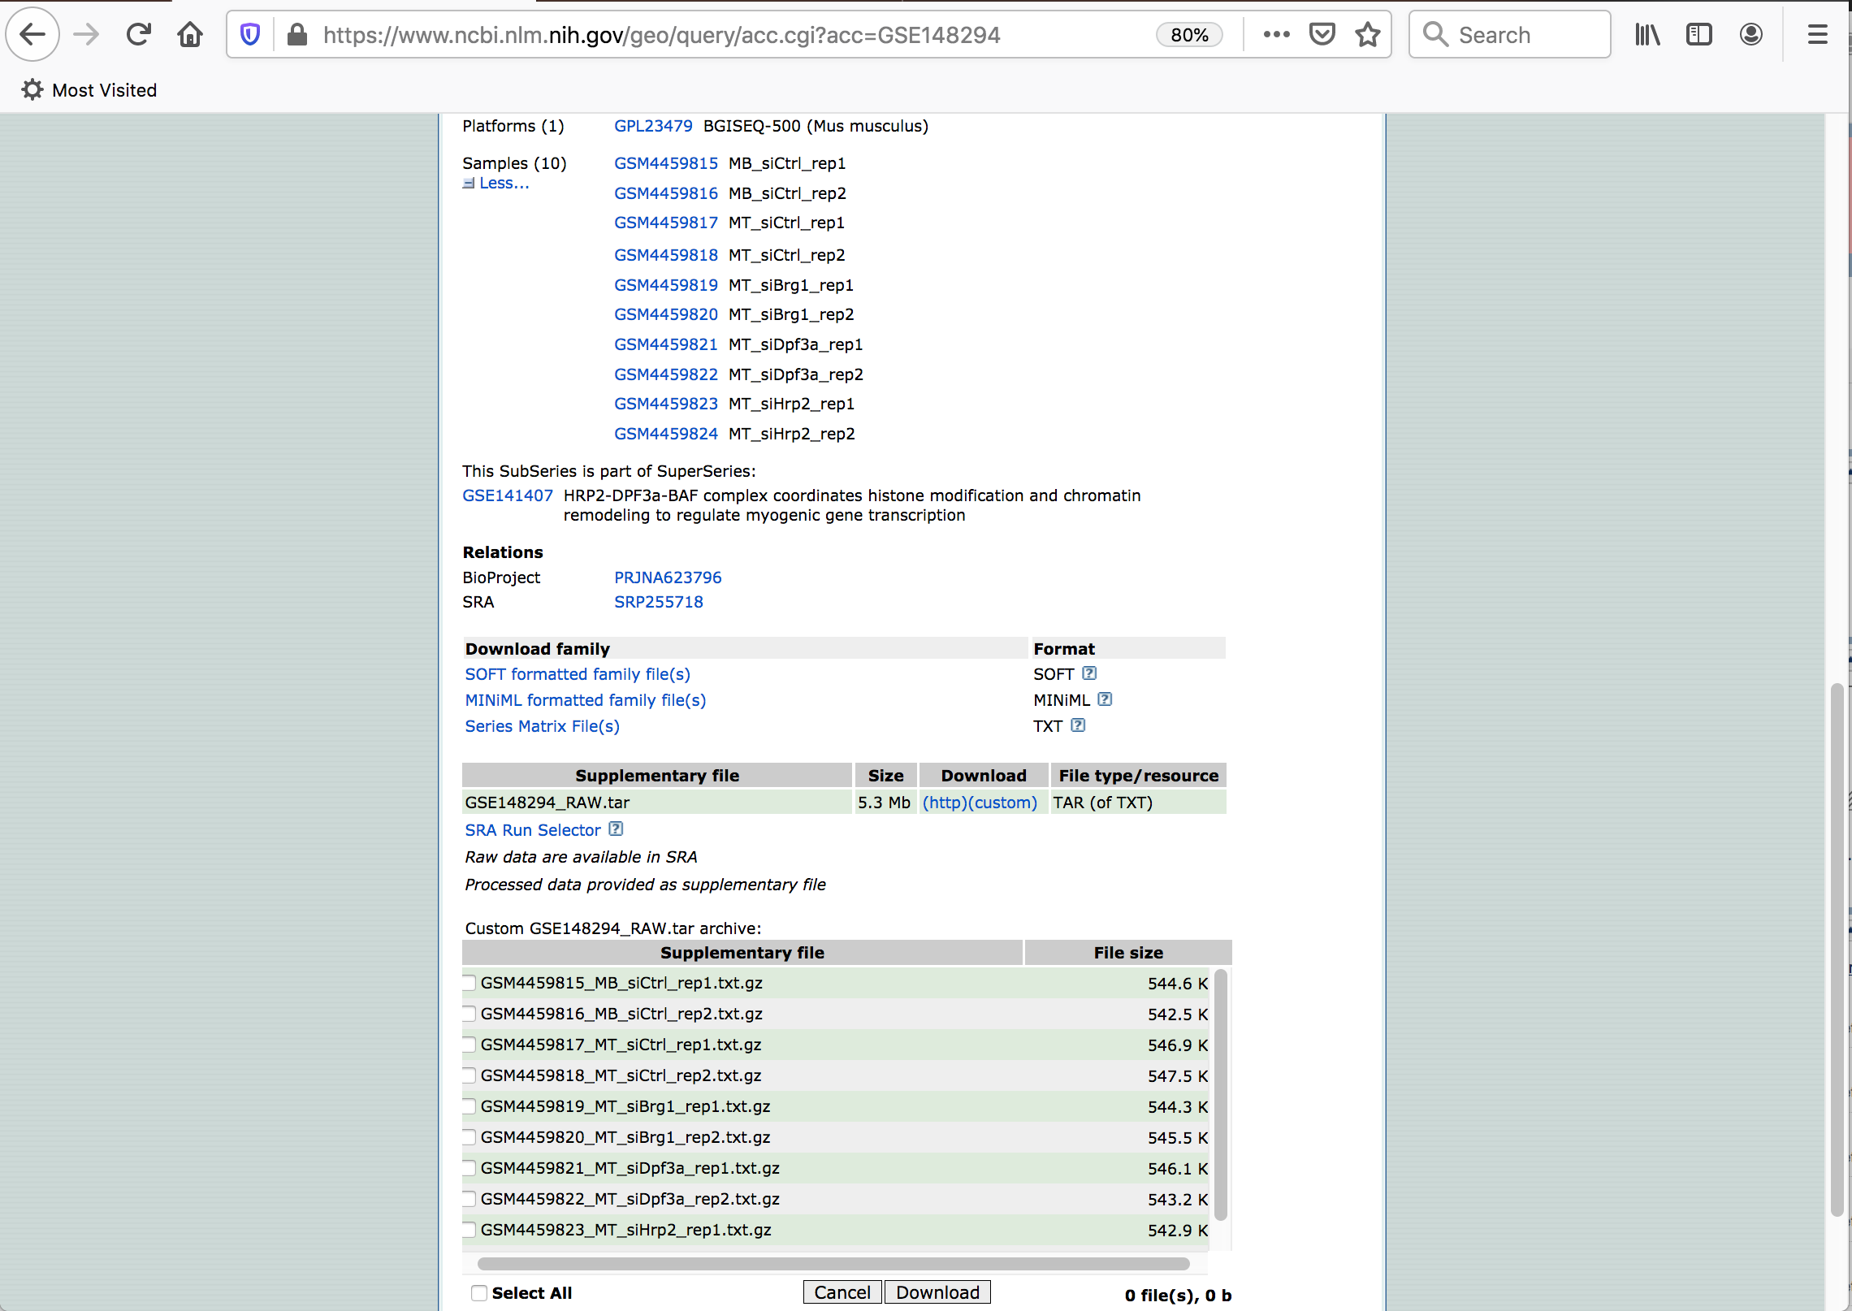
Dowonload those relevant to your study

Slide 11
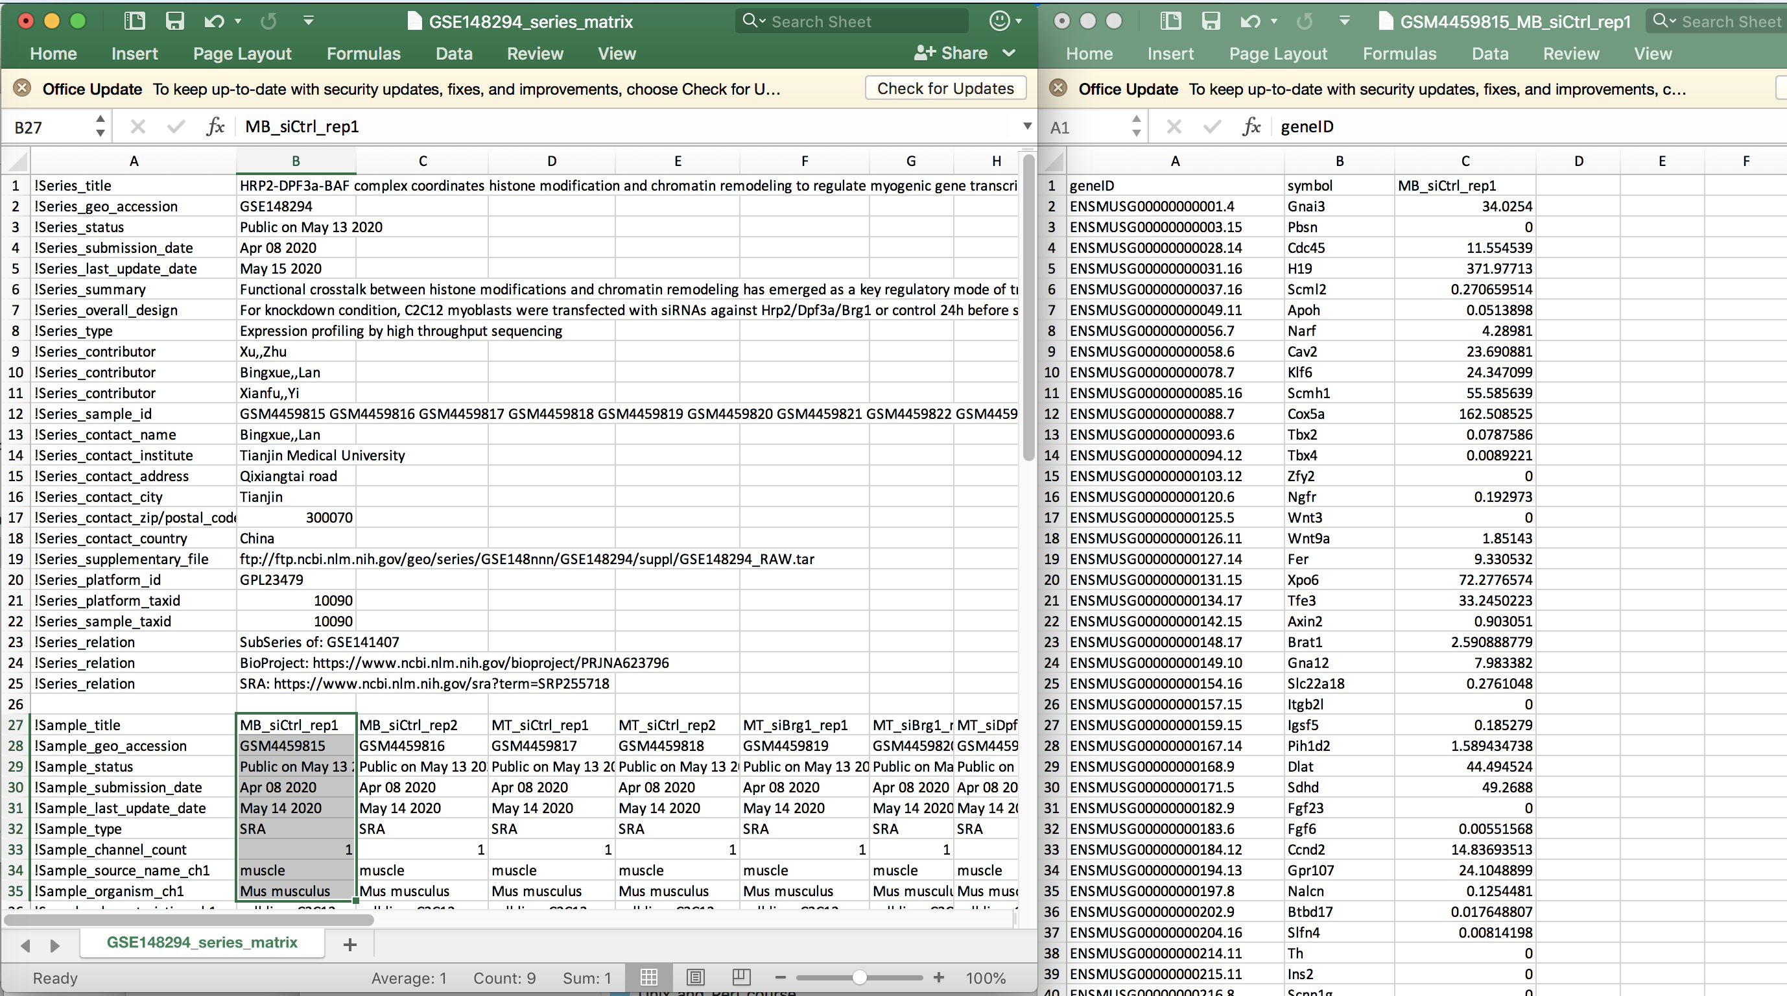
Series Matrix File
Processed File

Slide 12
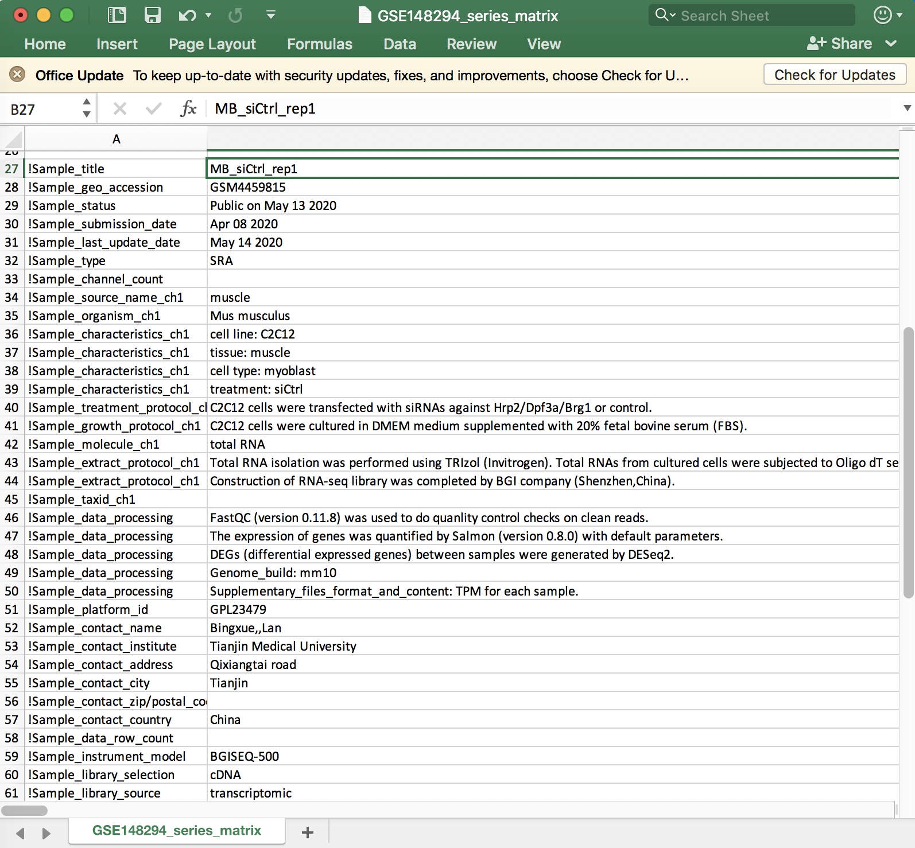
Series Matrix File
Supplementary files are displaying TPM data for RNA-Seq

Slide 13
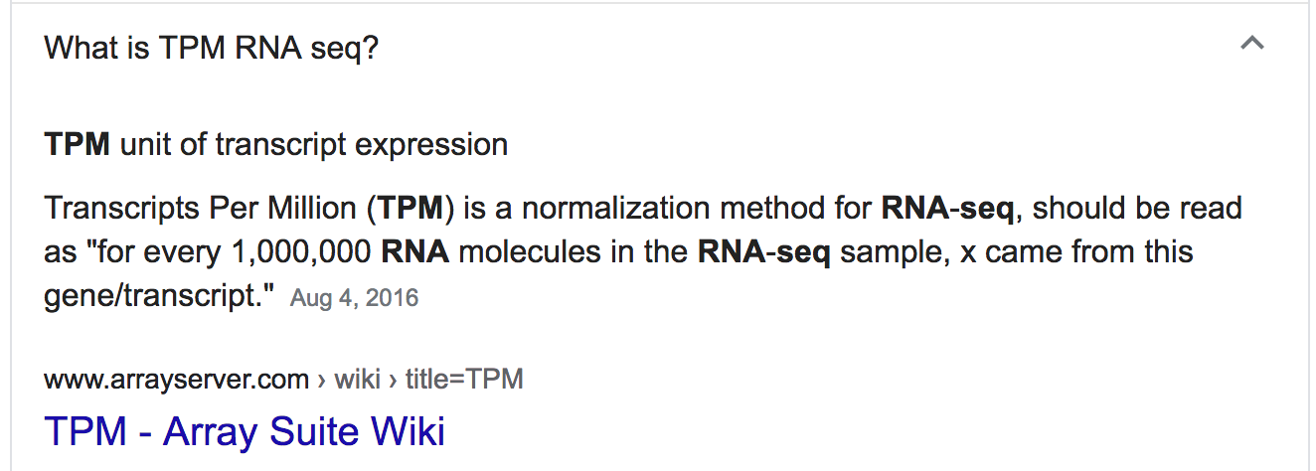

Slide 14
To get raw FASTQ files for a sequencing run, copy SRA number

Slide 15
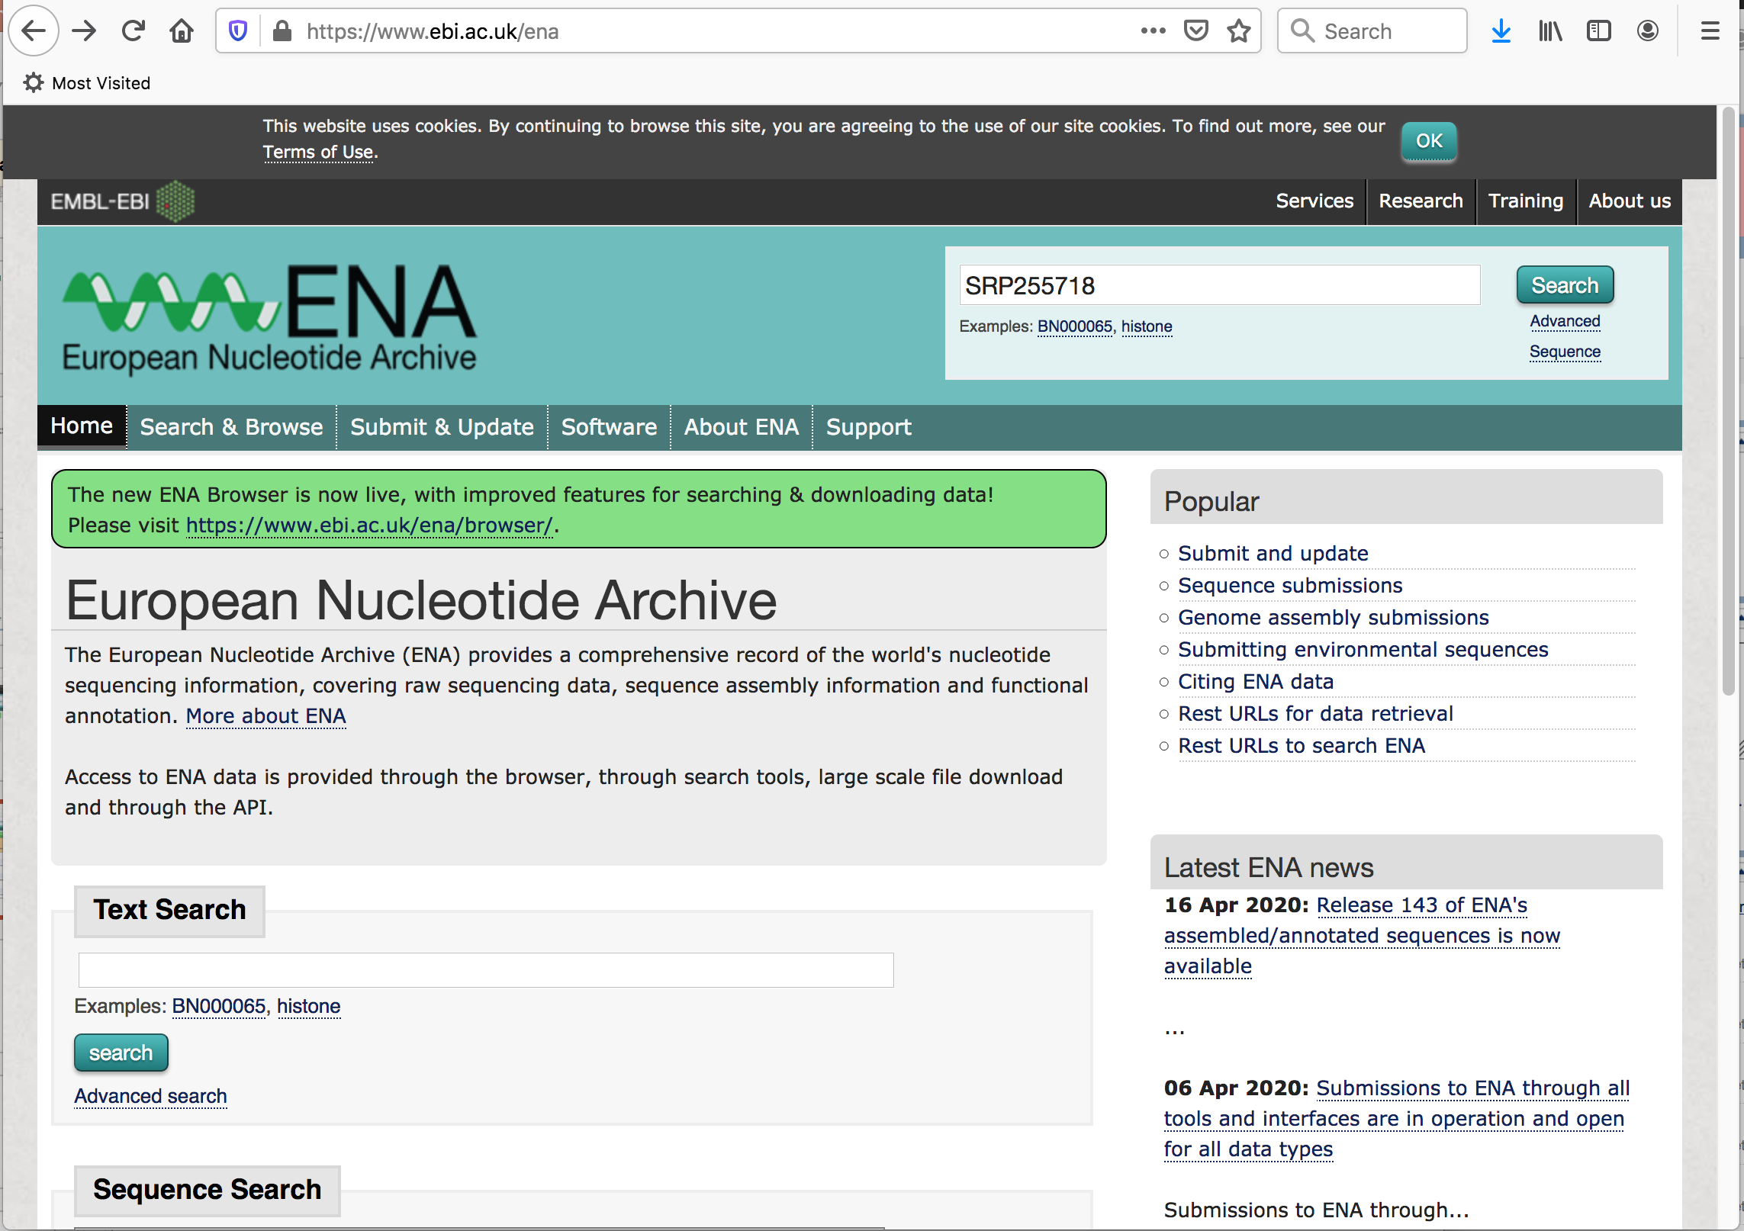

Slide 16
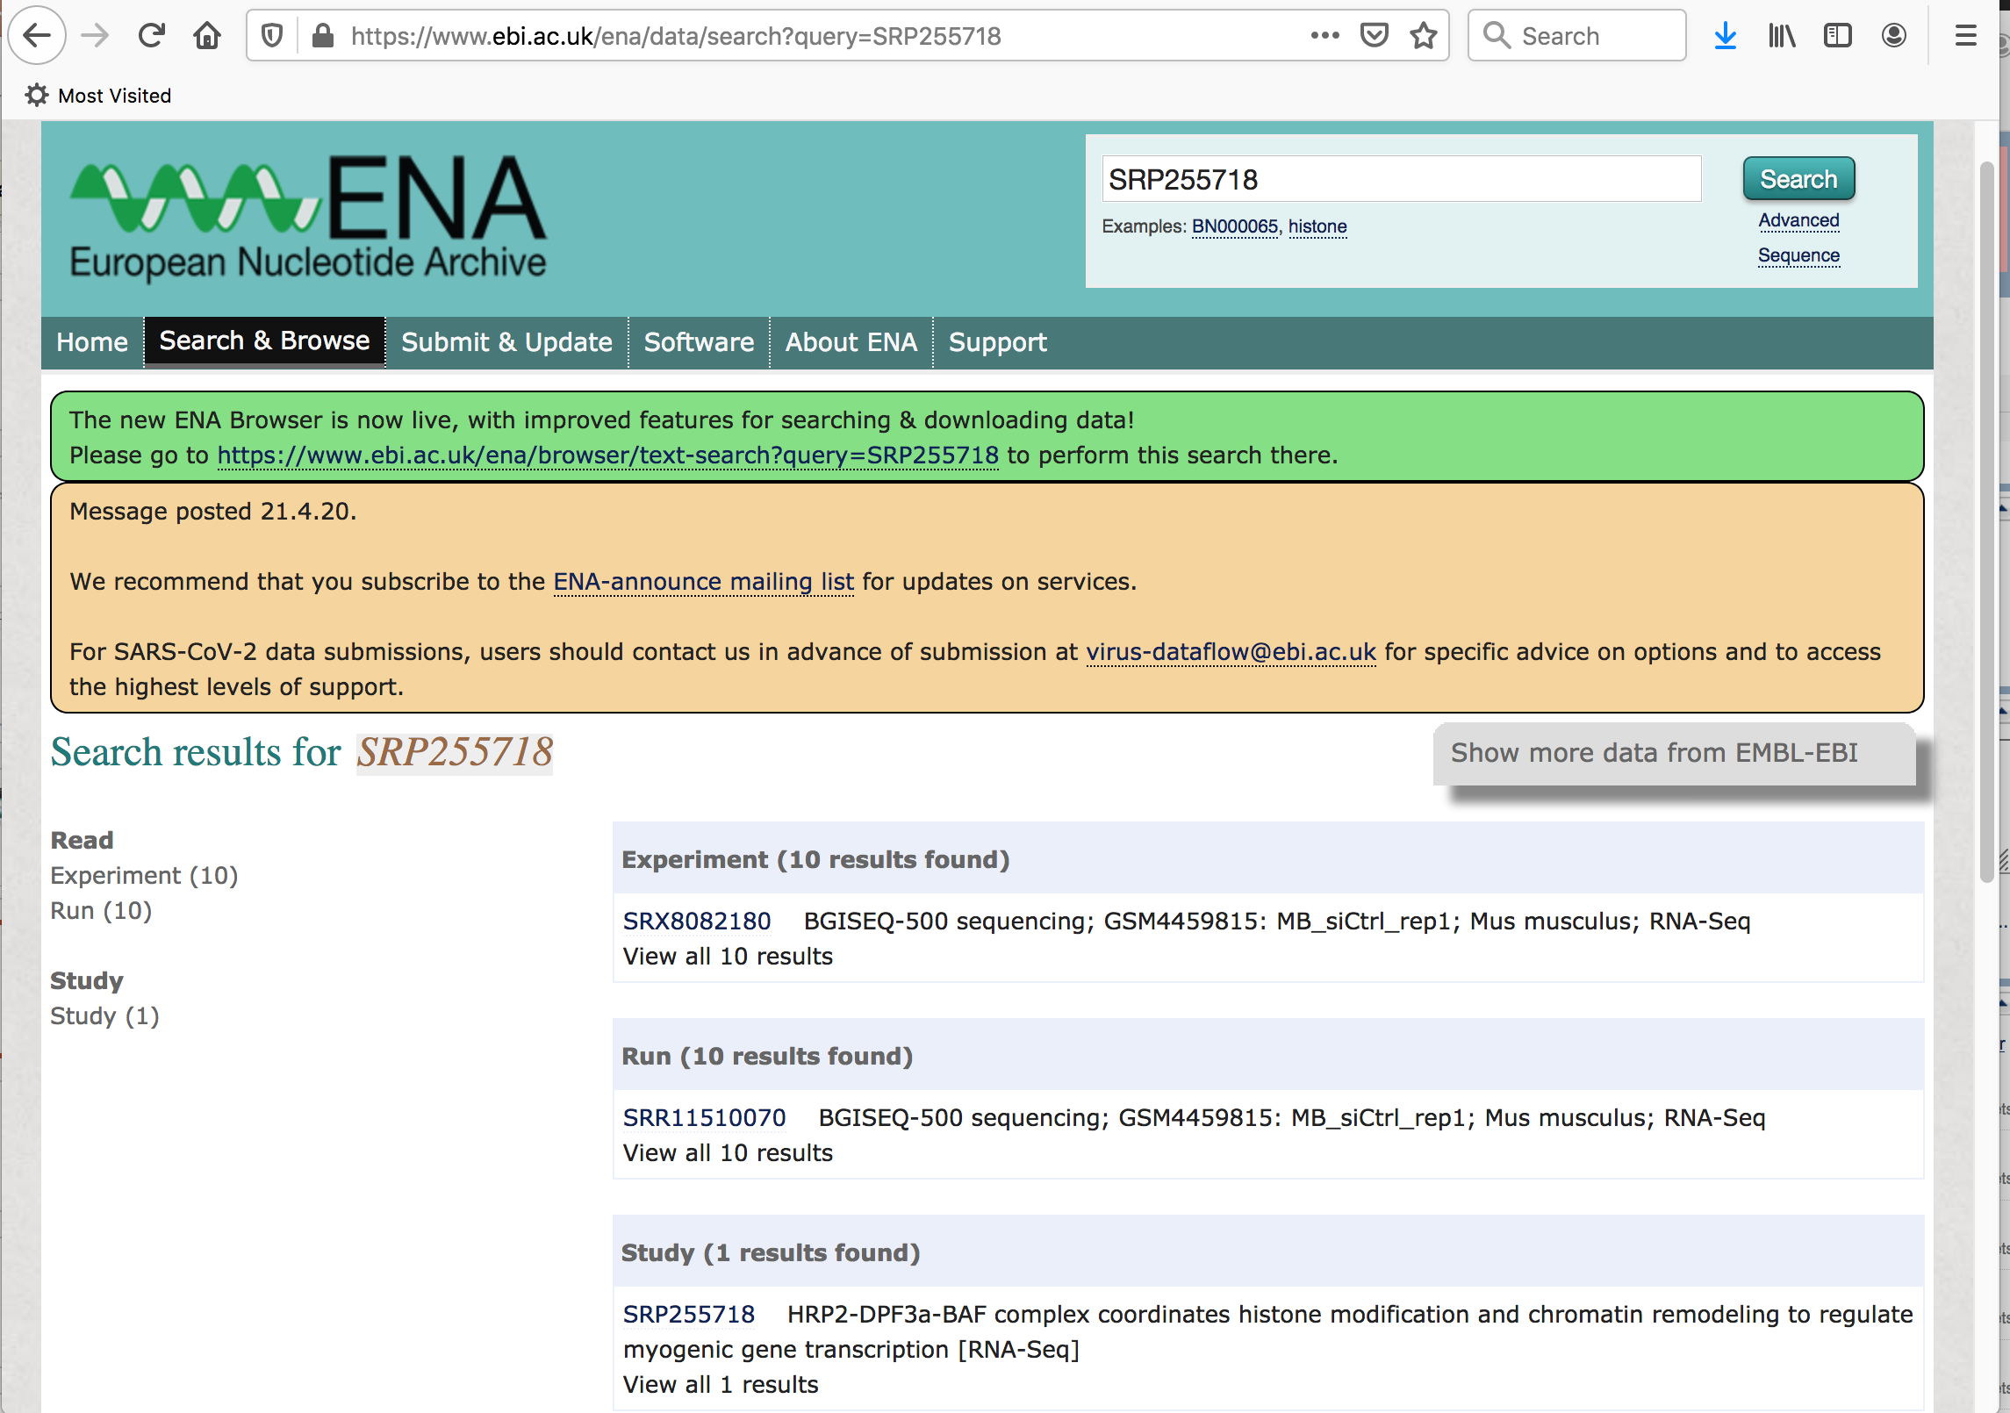

Slide 17
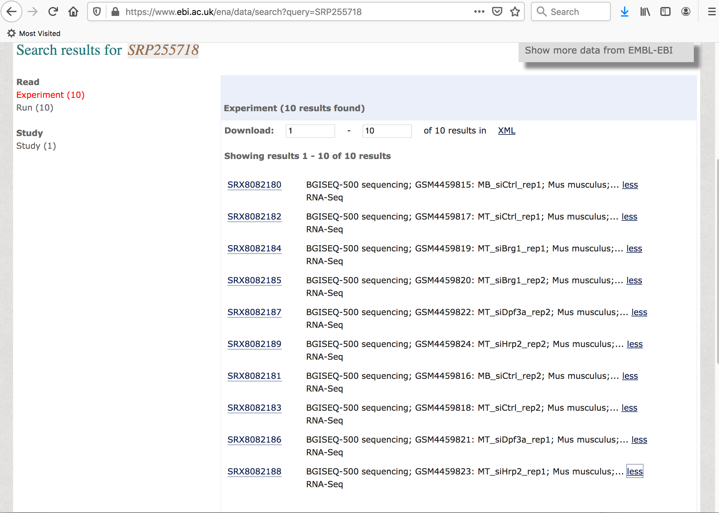

Slide 19
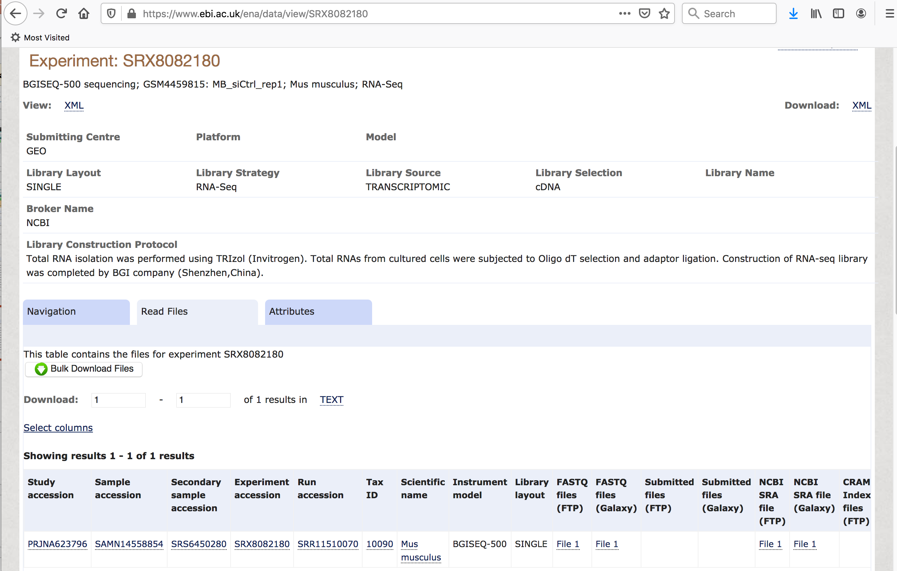
Download FASTQ file using this link

Slide 20
FASTQ file can be used for further data analysis

